Slide 1
Bay Shore Forum
June 28, 2017

Slide 2
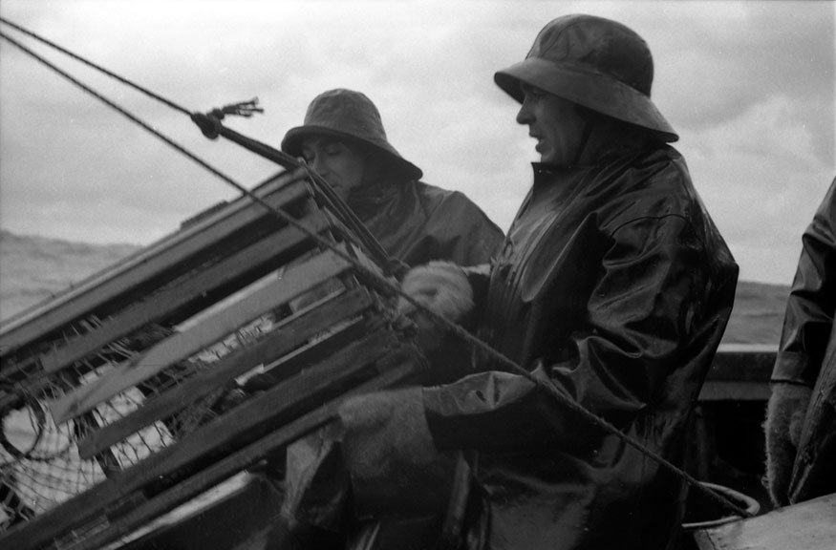
(https://novascotia.ca/archives/fundy/archives.asp?ID=27)

Slide 3
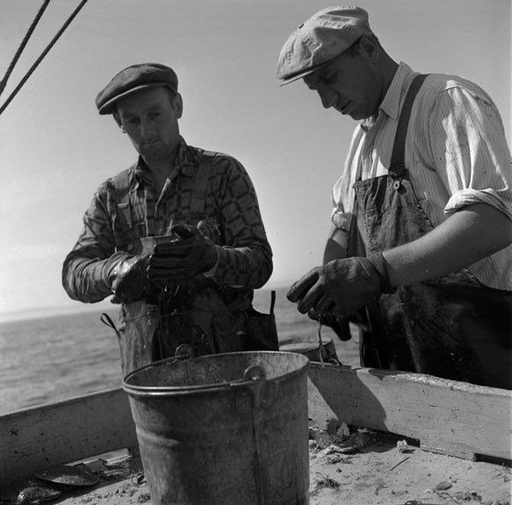
Wilfred Longmire on the right, Raymond Hudson on the left (https://novascotia.ca/archives/fundy/archives.asp?ID=27)

Slide 4
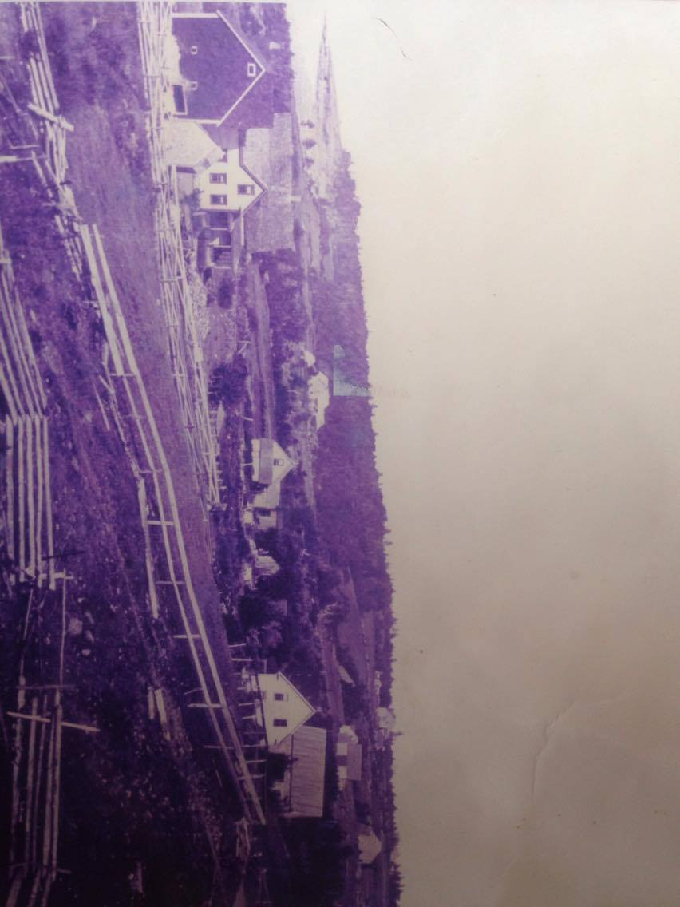
Hillsburn

Slide 5
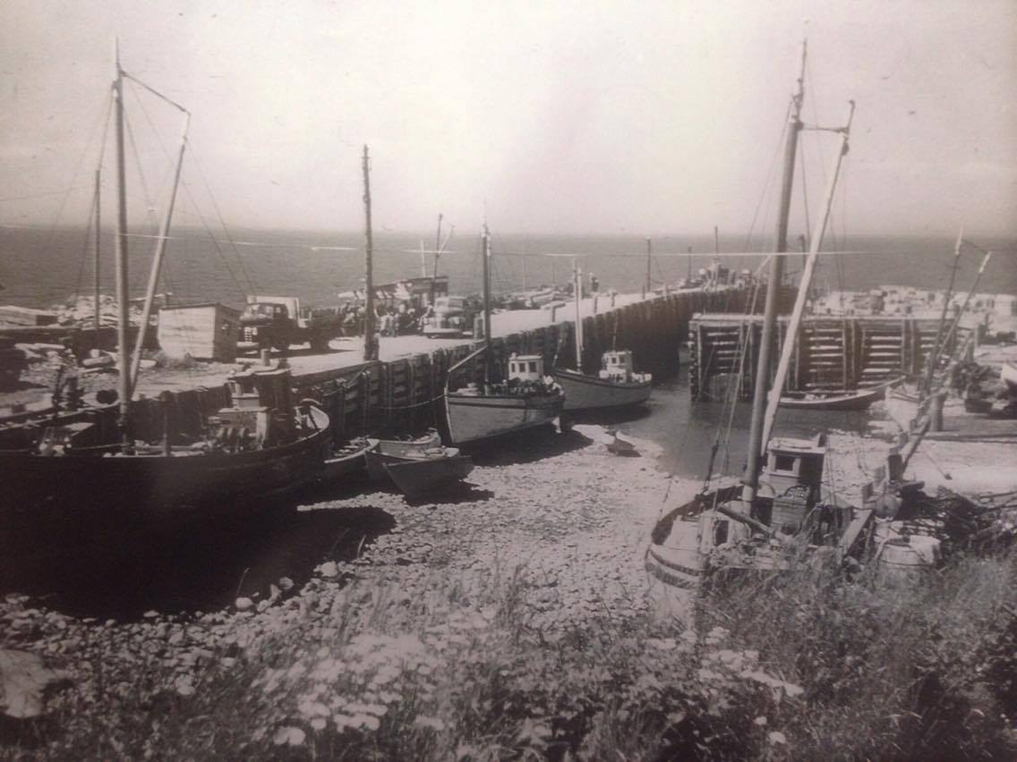
Notes:
2nd Boat on right – Della Mae, Next one is Bay Bird; On right side, the front boat is Lilipop

Slide 6
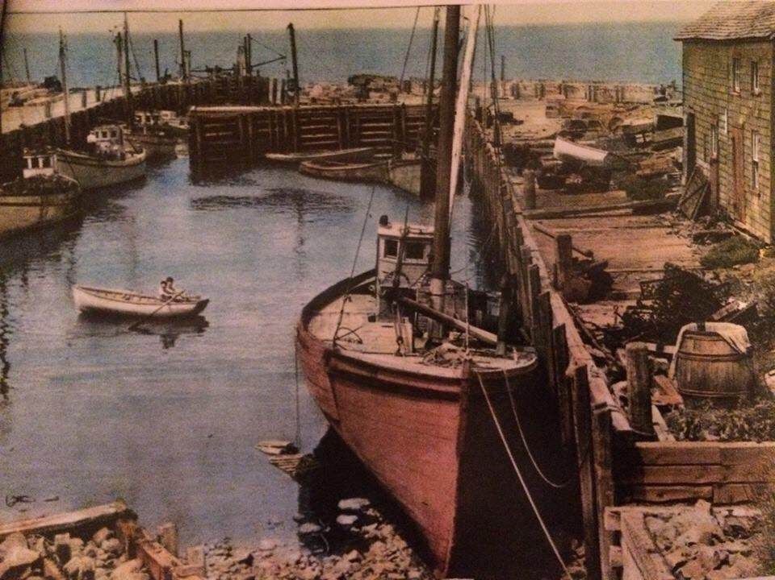
Hillsburn Wharf

Slide 7
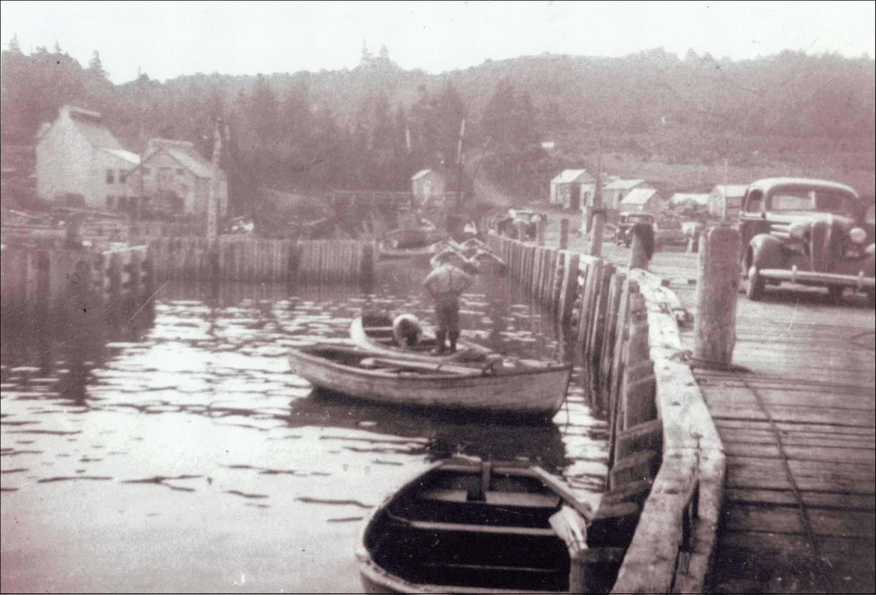
Hillsburn Wharf

Slide 8
Miss Gail – Hillsburn Wharf 1963 – built by James Longmire

Slide 9
Kathleen Crowe
431 ton tern schooner; built in 1917; built by J. Willard Smith of Saint John; built in Hillsburn. Owned by Ira Crowe of Windsor.
Was the second-last sailing vessel built in Hillsburn. Mr. Crowe was involved in the Windsor timber trade, so this vessel traded in lumber with locations to the South. Eventually sold to Portugese owners. (“Age of Sail” Armstrong and Wagner. 2000, 64, 196).

Slide 10
Ononette
483 ton tern schooner; 156’ X 35.2’ X13.2”; built in 1919; built by J. Willard Smith of Saint John; built in Hillsburn/Annapolis.Armstrong and Wagner explain that the Ononette was the last sailing vessel built in Hillsburn, built from the same mold as the Kathleen Crowe built two years earlier.
Captained by J. Willard Smith until sold to owners in Moncton who employed it trading between NS ports and New York. In 1930 this vessel ran aground and was lost in Advocate Harbour, NS while under the command of Captain Pike. (2000, pg 64) (Parker, 1959, p. 214) NO RECORD AT MARITIME MUSEUM FIND A WRECK?

Slide 11
Ivaca
43 ton schooner; built in 1873 (Armstrong and Wagner, 194: 1874); built by Hiram Longmire; built in Hillsburn. Owned by ?.
The second ship owned and operated as a ferry and freight service between Saint John and Bridgetown by Captain John H. Longmire. ( “Age of Sail” Armstrong and Wagner. 2000, 35, 63, 194)

Slide 12
S. J. Bogart
836 ton barque; Built in 1873; built by William Weatherspoon, John Johnson Sr. and Robert Mills; built in Hillsburn, NS. Owned by ?
At the time, Hillsburn was referred to as Granville, Bayside. (“Age of Sail” Armstrong and Wagner. 2000, 2, 63, 72, 203).

Slide 13
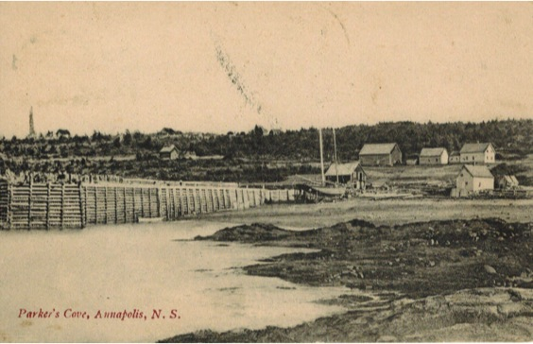
Parker’s Cove

Slide 14
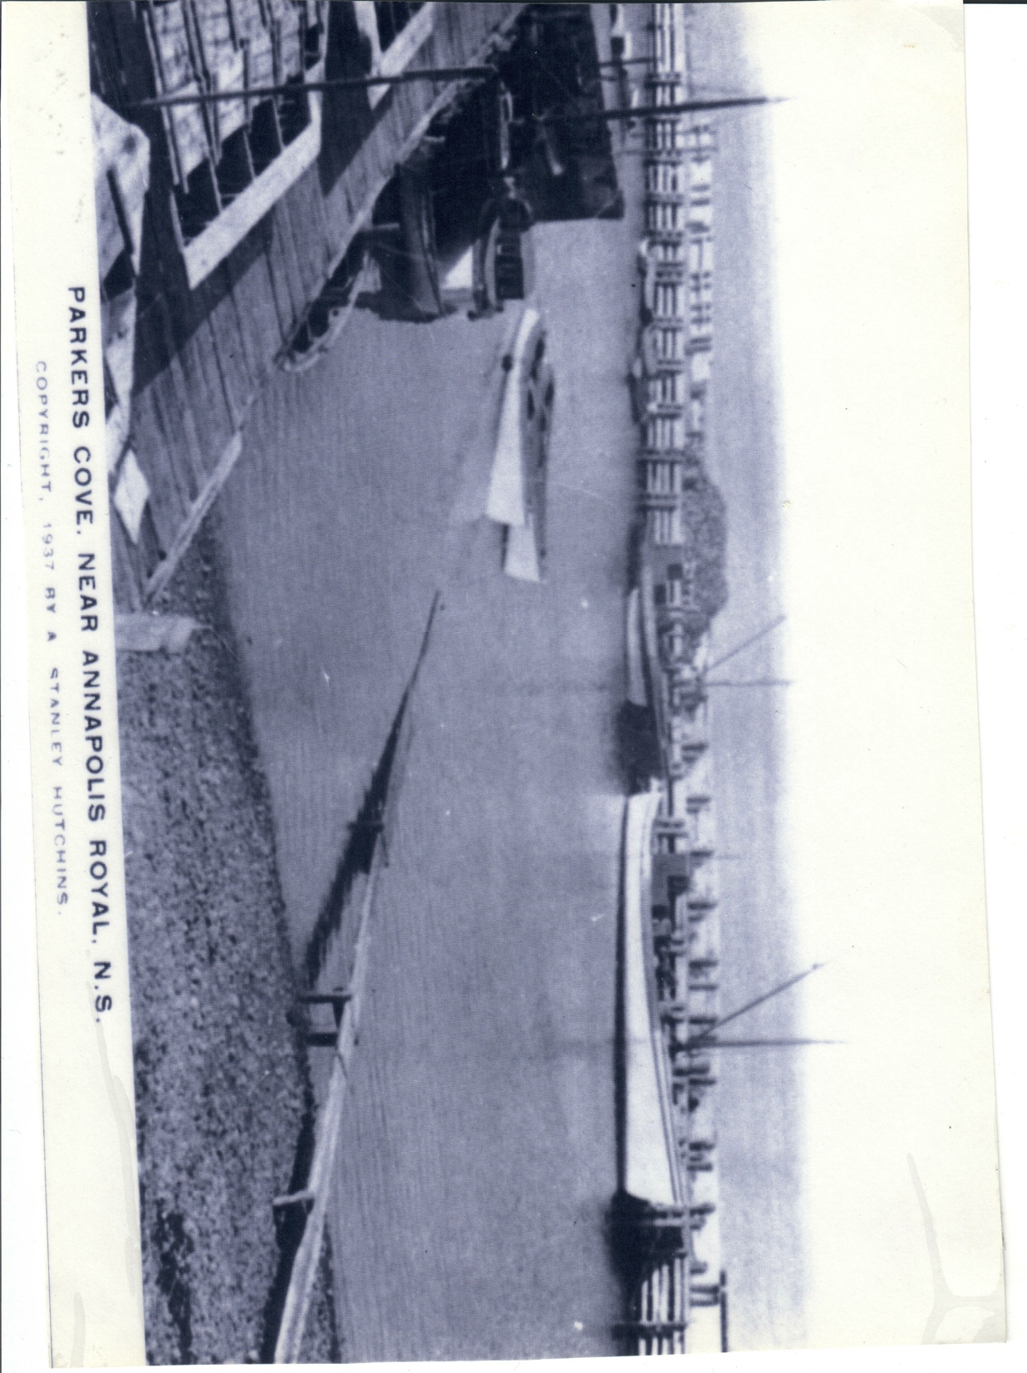
Parker’s Cove

Slide 15
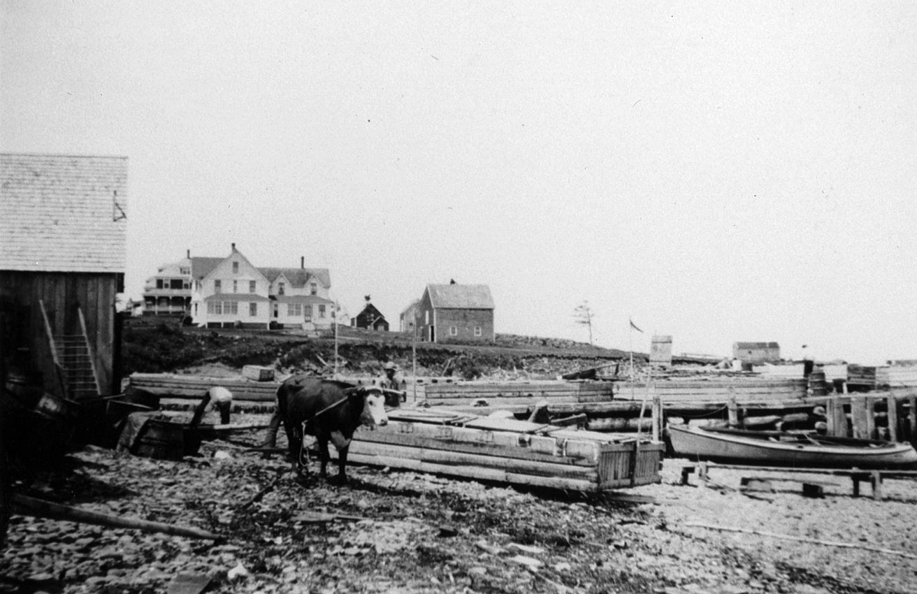
Parker’s Cove

Slide 16
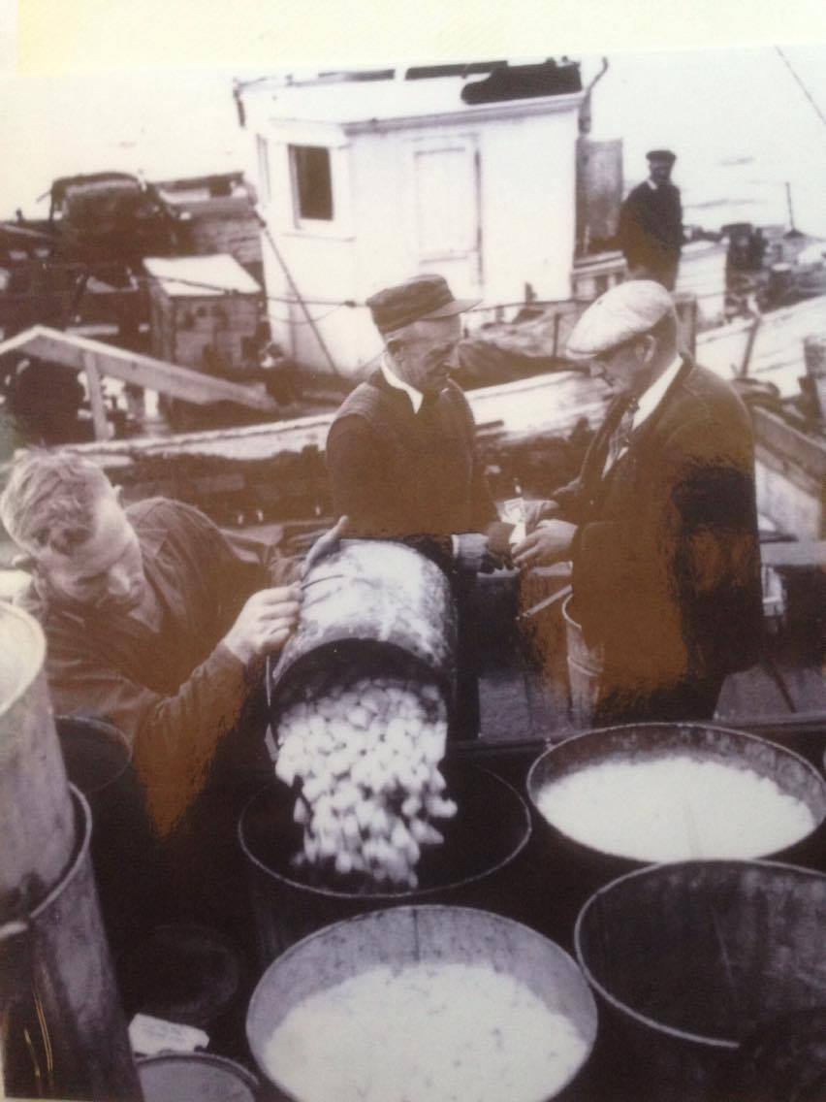
Wilbur Robinson, Bud Oliver, and Elwood Oliver as it appears.

Slide 17
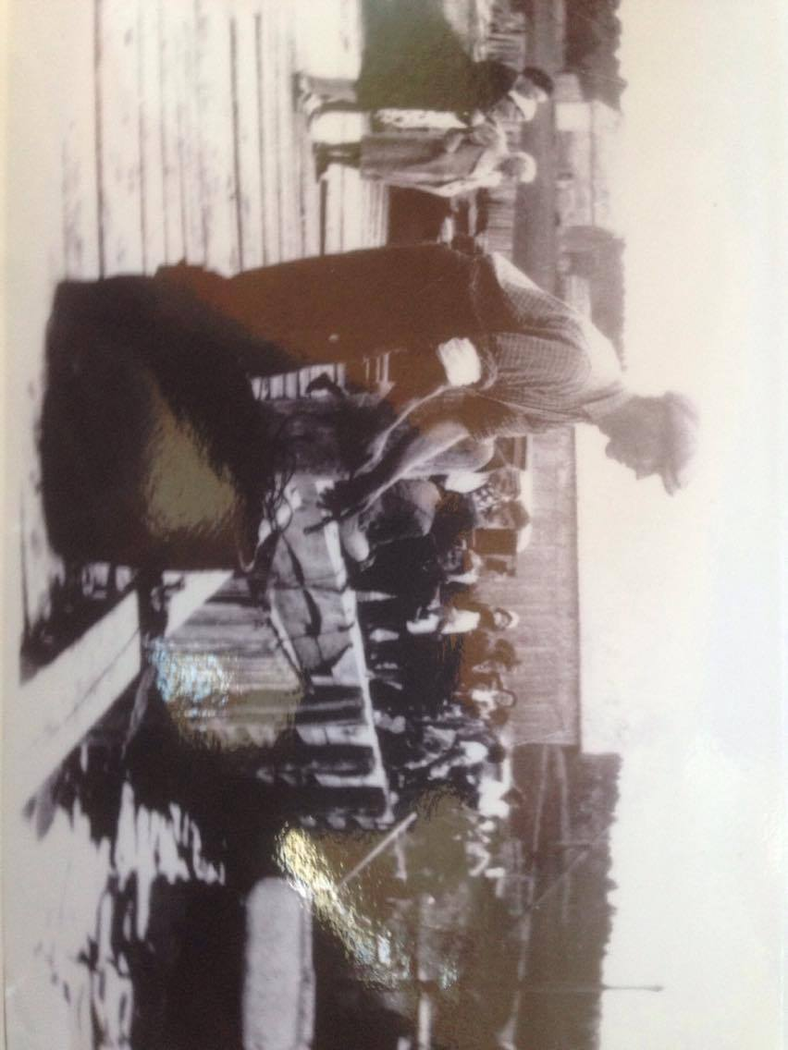
Herb Clayton

Slide 18
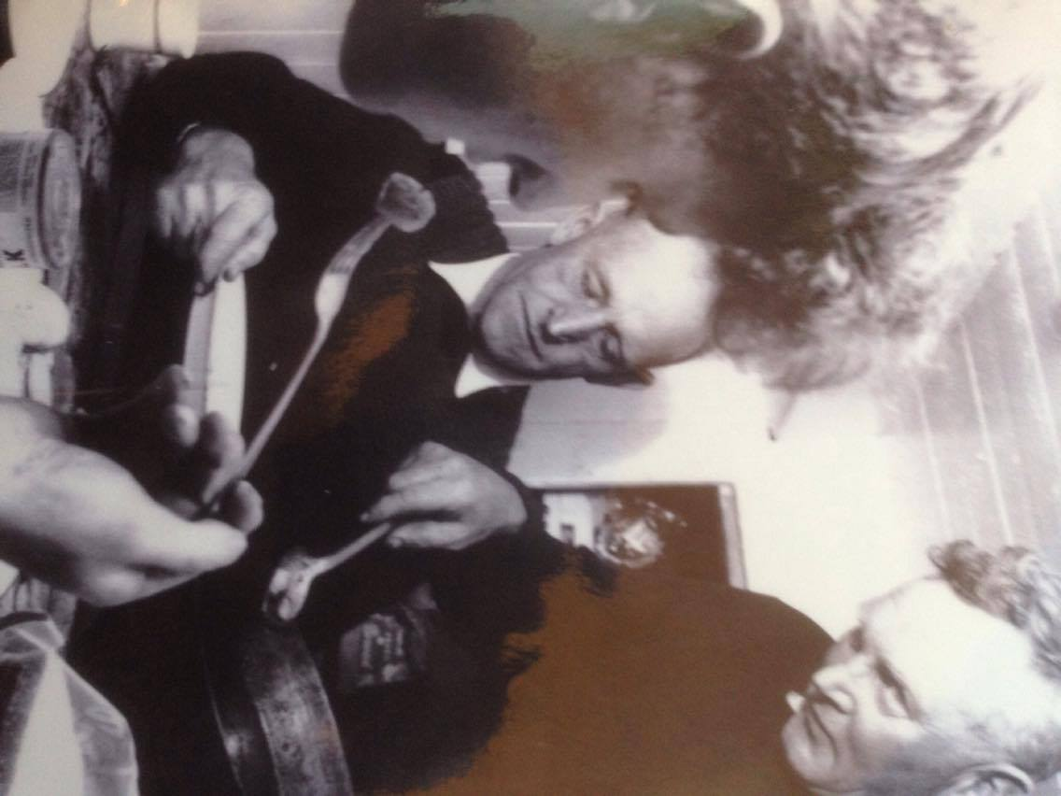
In the Forecastle (focsel) of the boat

Slide 19
Francis
47 ton (A&W p 191: 37 ton) schooner; built in 1860; built by ?; built in Parker's Cove. Owned by ?.
One the earliest vessels built in Parkers Cove, was wrecked in 1868 on the Bay shore. (“Age of Sail” Armstrong and Wagner. 2000, pg 60, 191) (NOTE: “Age of Sail” Index lists Granville as building location, 191).

Slide 20
H. K. Richards
32.8 ton two-masted fishing schooner; built in 1877; built by Thomas Milner; built in Parker's Cove. Owned by W. H. Foster, Raymond Foster, David Hudson, E. P. Gilliatt, C. H. Milbury, William Gilliatt and David Milbury.
This vessel is named after the Delap yards head ship builder at the time. In 1893 it sank in the Bay of Fundy. (“Age of Sail” Armstrong and Wagner. 2000, 60) (NOTE: “Age of Sail” Index lists Granville as building location, 193).

Slide 21
Lloyd
WEIGHT;39-ton about 48 feet long with a 16 foot beam (Wallace, 1955, 98); two-masted schooner; built in 1883; built by ?; built in Maitland Nova Scotia (p. 98). Owned by Captain Herbert Anderson. Sailed as a packet ship between Parkers Cove and Saint John (Armstrong and Wagner, 2000, 62).
The Llyod was mentioned in the autobiography of “Fredrick William Wallace,” in which he states the boat was 29 years old in the year 1912 – meaning it was built in 1883 (p. 98). On this day, in 1912, Wallace was leaving Hillsburn, after visiting his fishing friend, Captain Arthur Longmire (Walter Longmire’s Grandfather) (p. 98). The Llyod departed from Parker’s Cove Wharf enroute for Digby. The Lloyd was carrying a load of salt dried fish and three other people, including Wallace (p. 98).

Slide 22
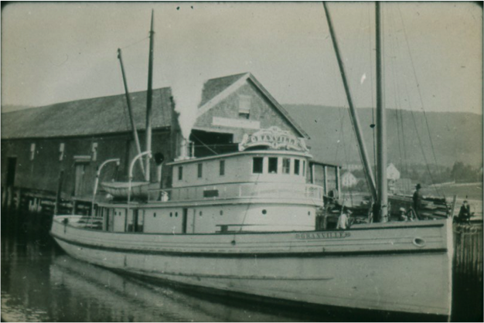
The Granville – Said to have been built at Parker’s Cove (AHS photo).

Slide 23
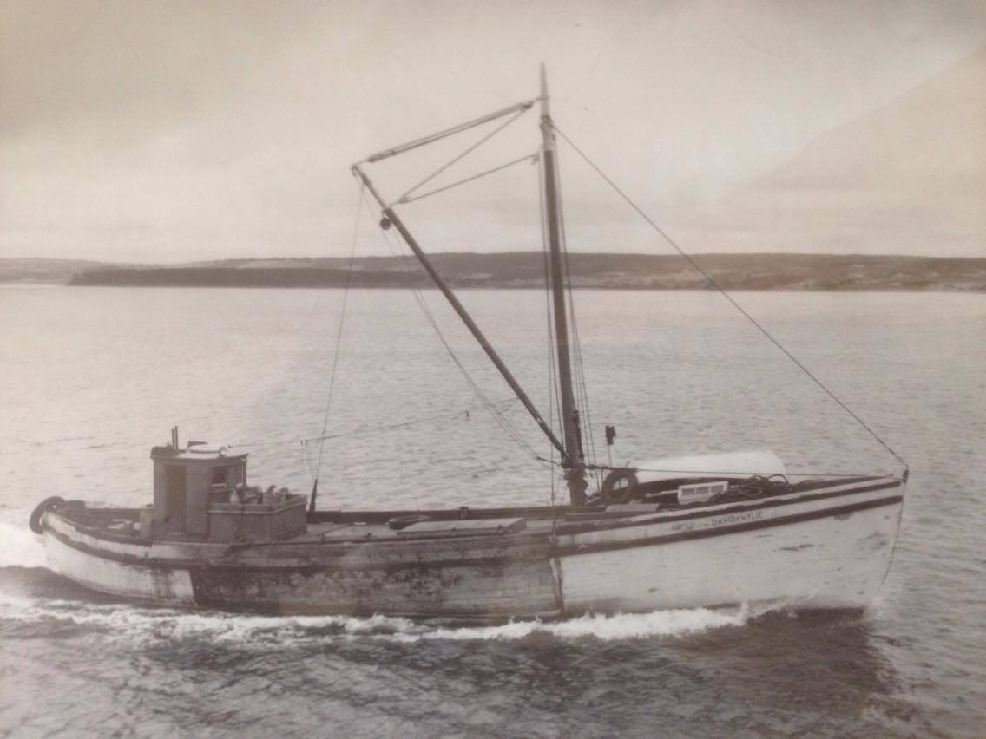
The David & Wylie

Slide 24
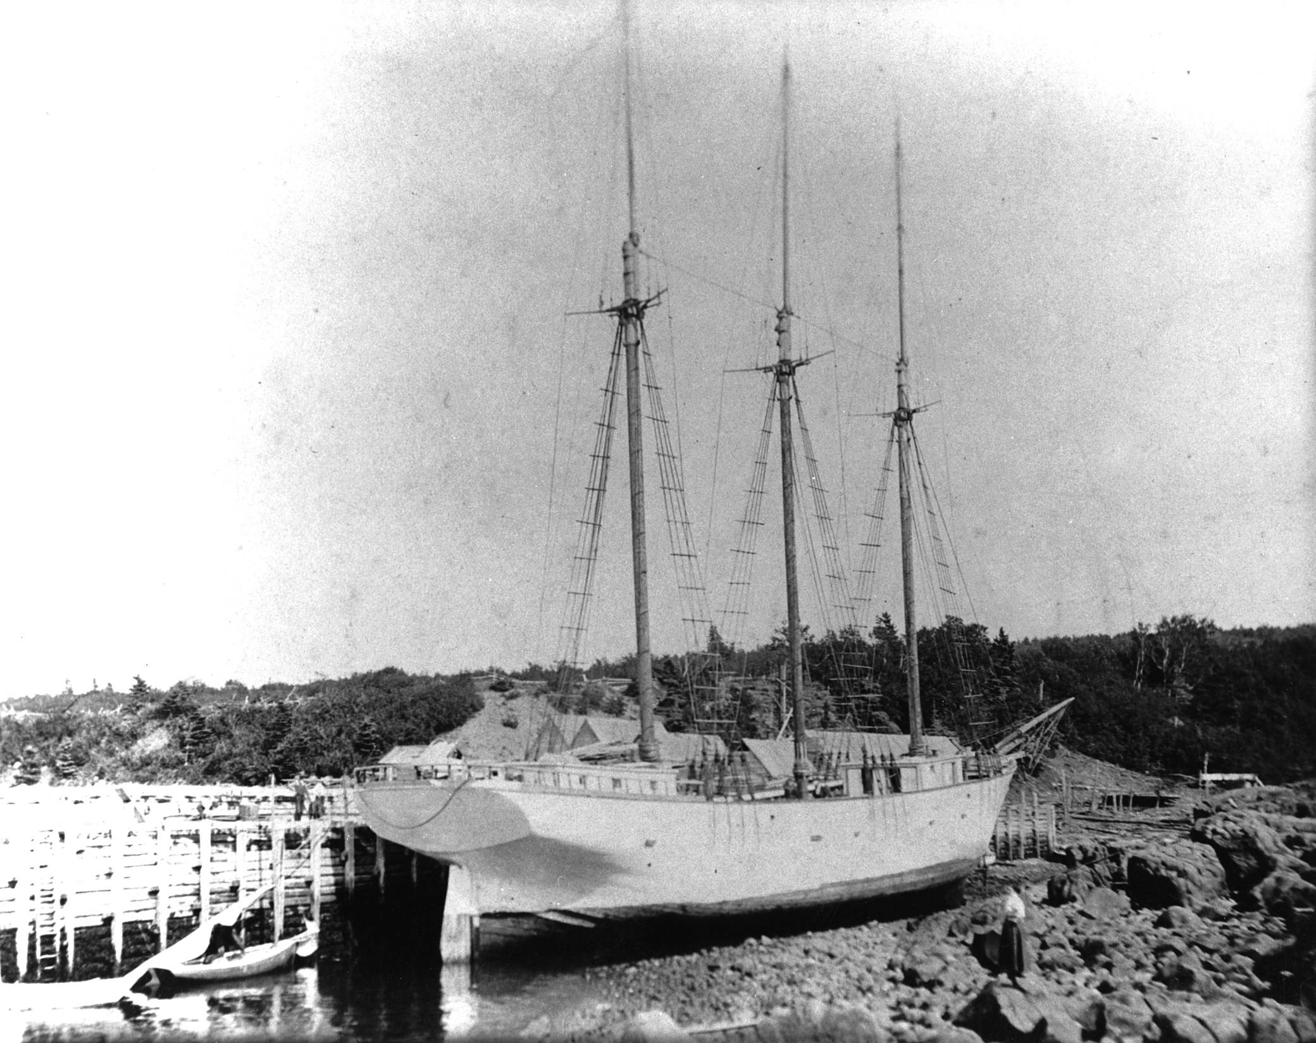
Delaps Cove Barque

Slide 25
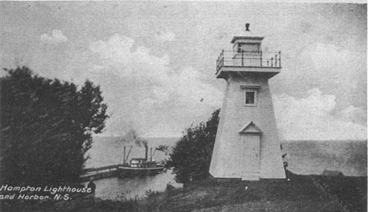
Hampton

Slide 26
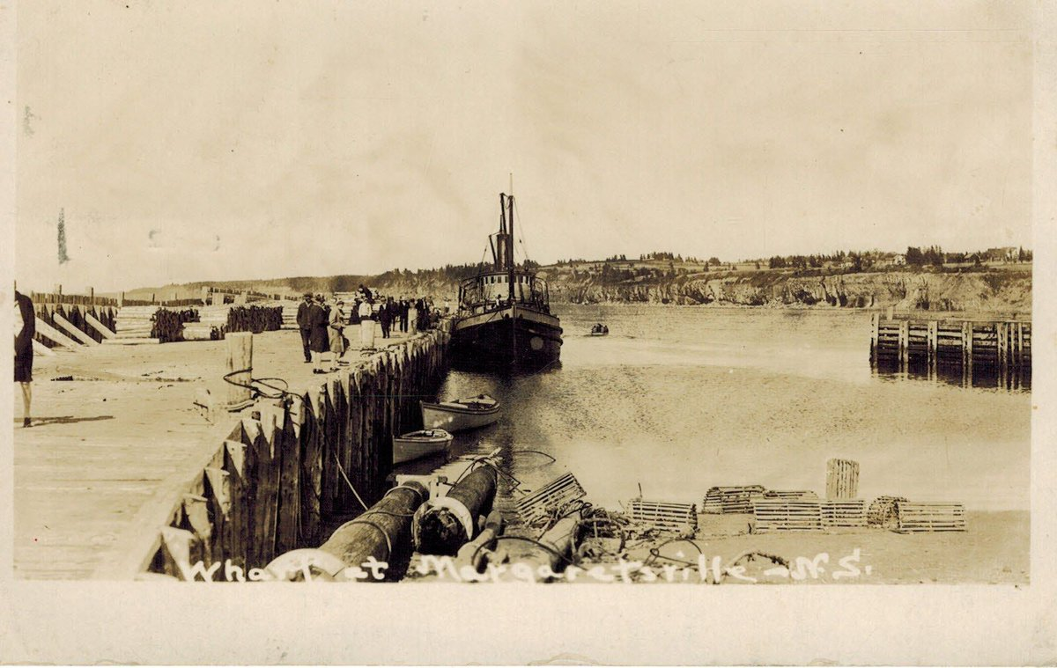
Margaretsville (online source).

Slide 27
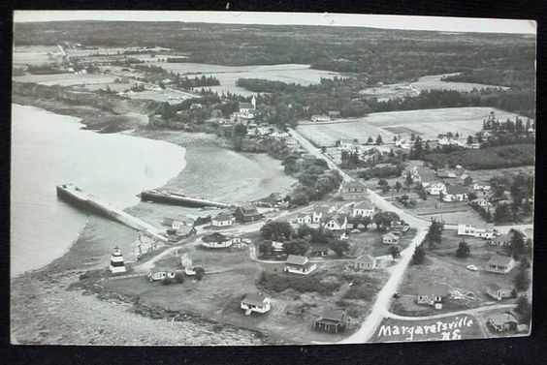
Margaretsville (online source)

Slide 28
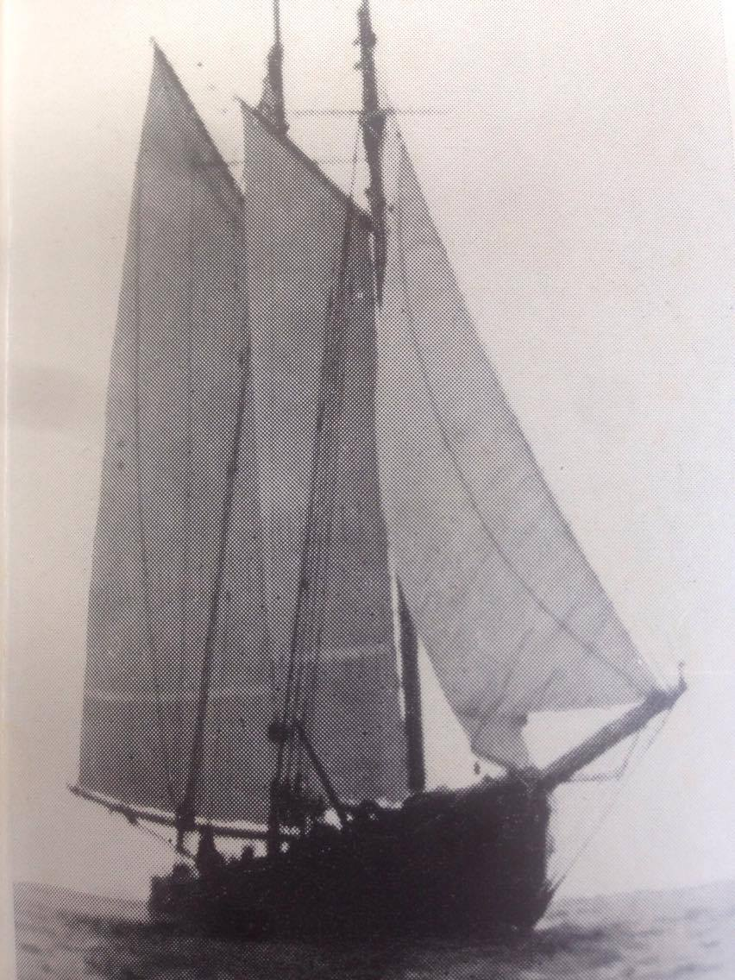
Dorthy Smart (Wallace, 1955, p. 47)

Slide 29
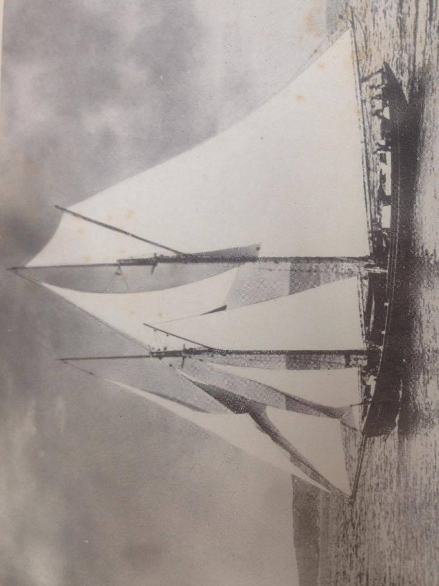
Albert J. Lutz (Wallace, 1955, p. 250).

Slide 30
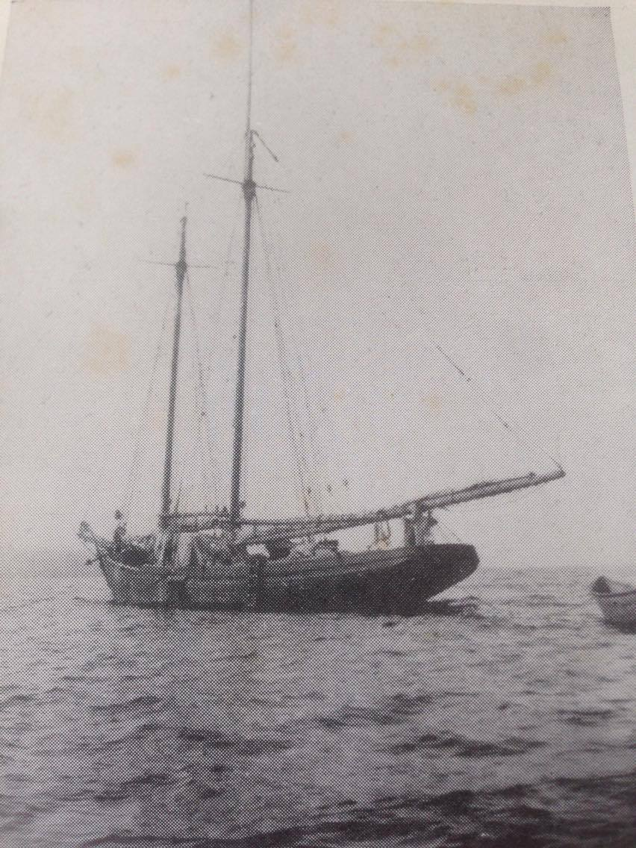
Effie Morrissey (Wallace, 1955, p. 123).

Slide 31
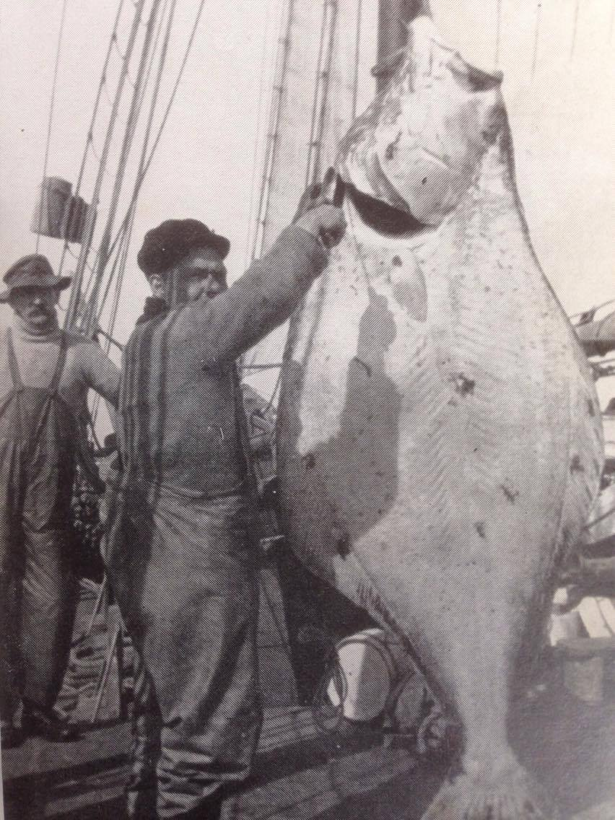
Scaling about 280-lbs caught on the Anticosti grounds (Wallace, 1955, p. 187).

Slide 32
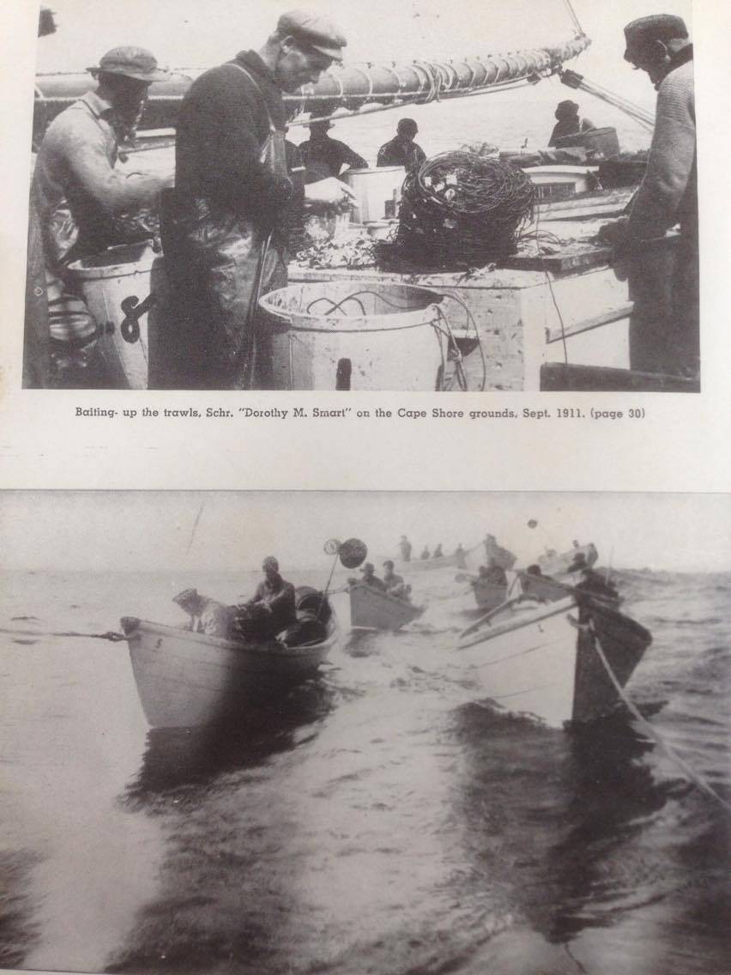
Possibly, Jim Tidd & Judson Handspiker (Wallace, 1955, p. 58).

Slide 33
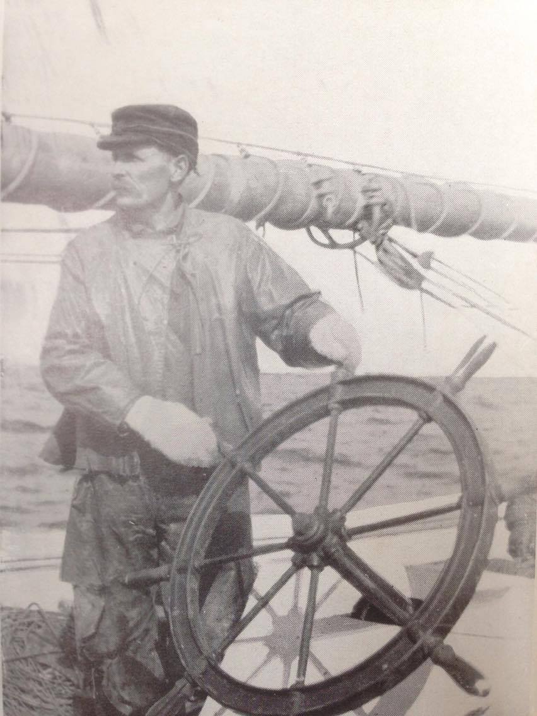
Captain John Apt of the Lutz (Wallace, 1955, p. 186).

Slide 34
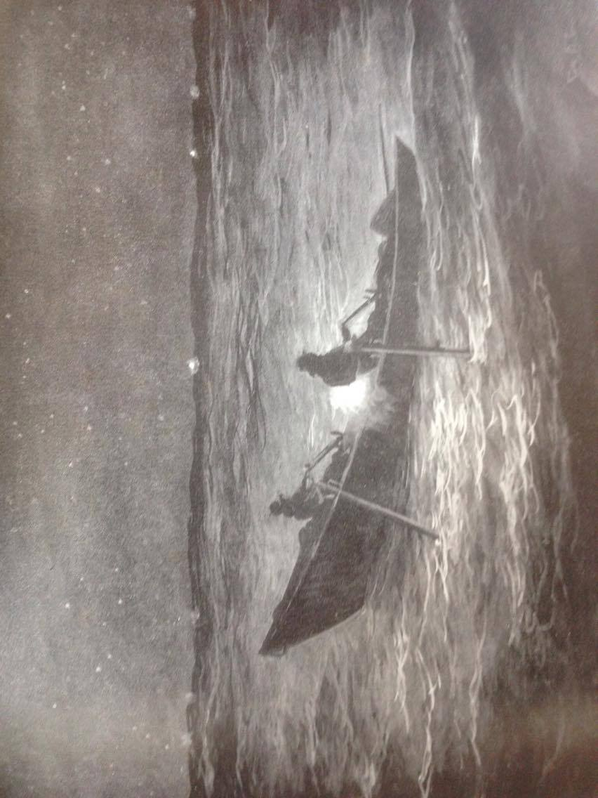
Making night sets – a drawing by George A. Cuthberison

Slide 35
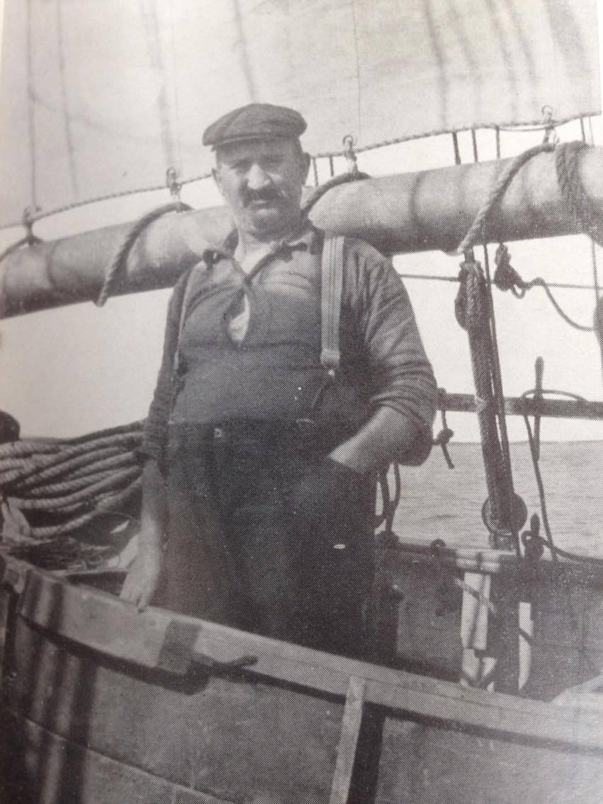
Jerry Boudreau – Cook aboard the Lutz (Wallace, 1955, p. 186).

Slide 36
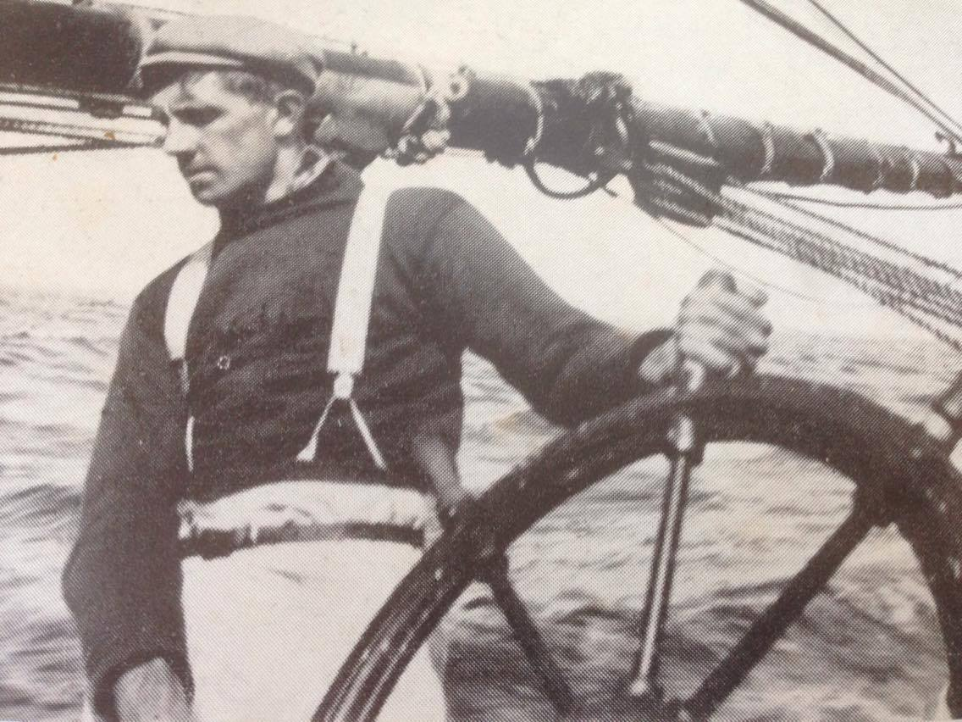
Skipper Harry Ross – 1911 – Dorthy Smart (Wallace, 1955, 59).

Slide 37
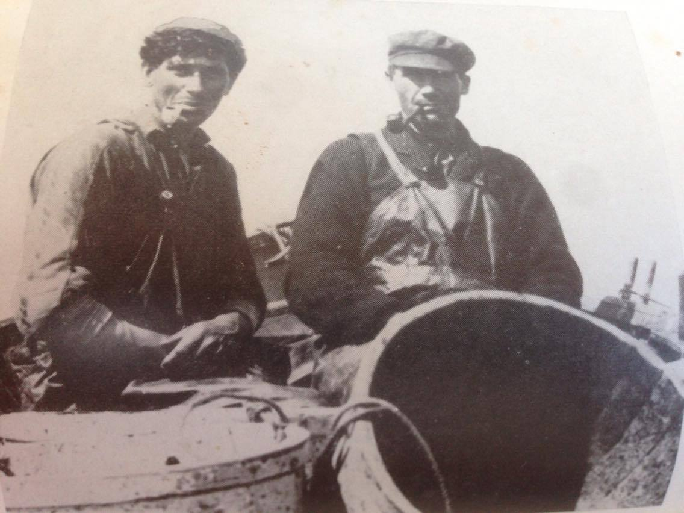
Enjoying a smoke after setting the trawls (Wallace, 1955, p. 48).

Slide 38
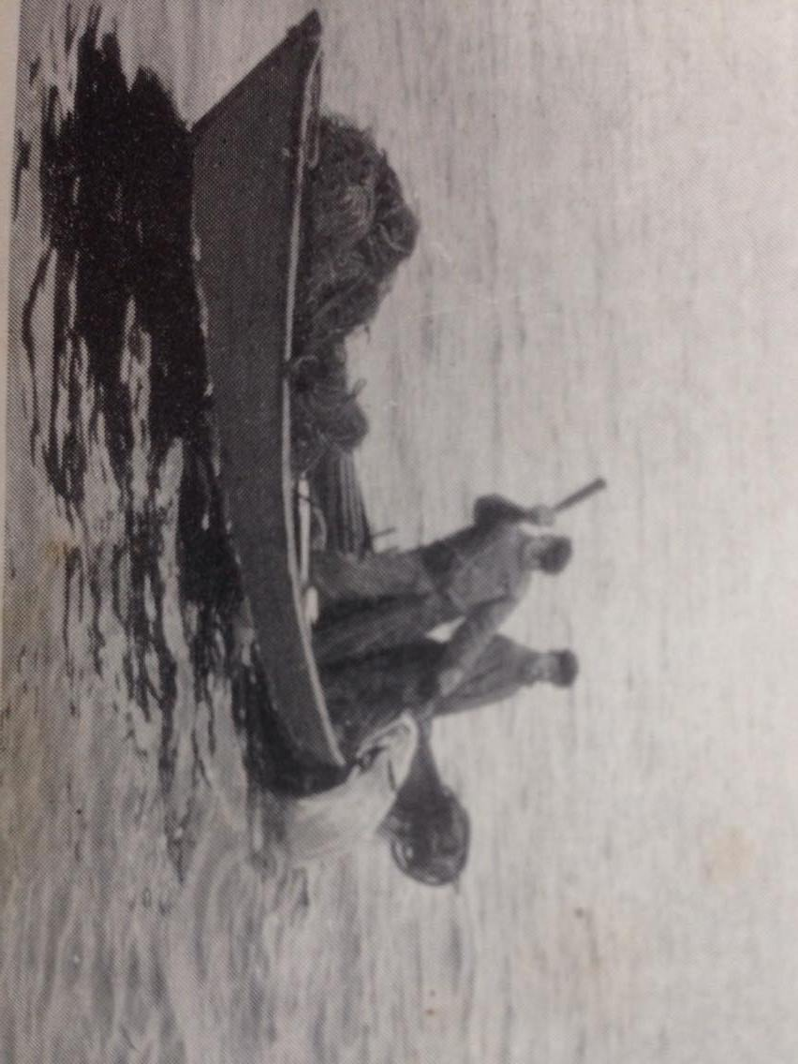
The Halibut Killer!!
Notes:
199 – Biggest trip of halibut ever landed by a Canadian vessel on the Atlantic coast, especially for an eight dory vessel - 1913

Slide 39
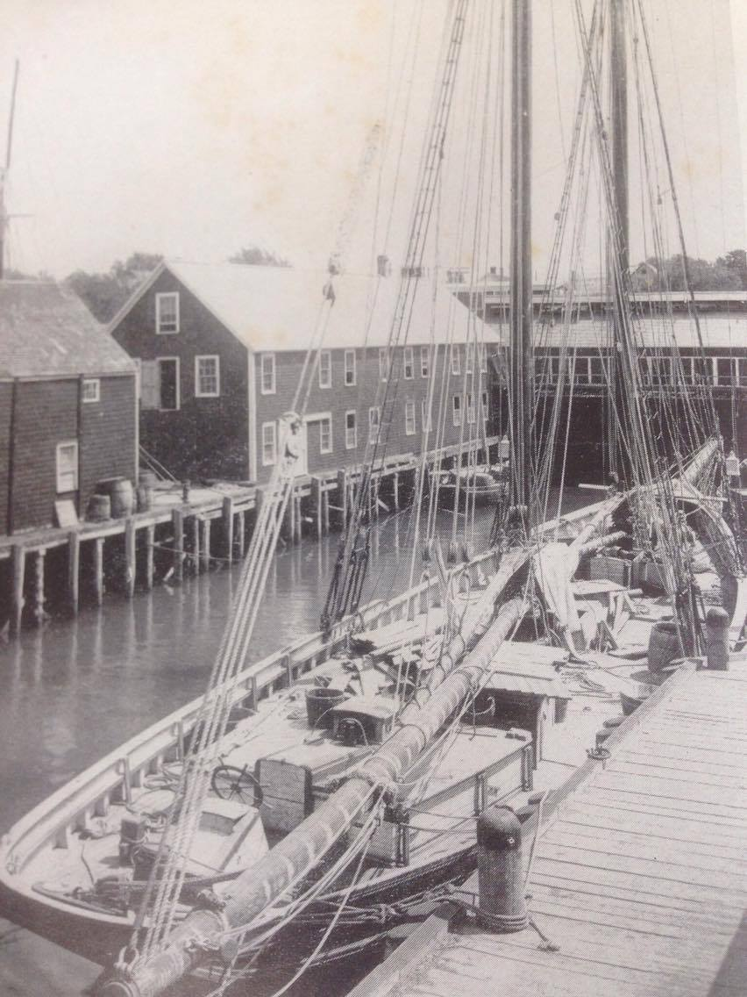
Albert J. Lutz – 1917 (Wallace, 1955, p. 333).

